Slide 1


Azərbaycan Dövlət Neft və Sənaye Universiteti
Calculus
Single Variable

Slide 2
Continuity and One-Sided Limits

Slide 3
Outline
Determine continuity at a point and continuity on an open interval.
Determine one-sided limits and continuity on a closed interval.
Use properties of continuity.
Understand and use the Intermediate Value Theorem.

Slide 4
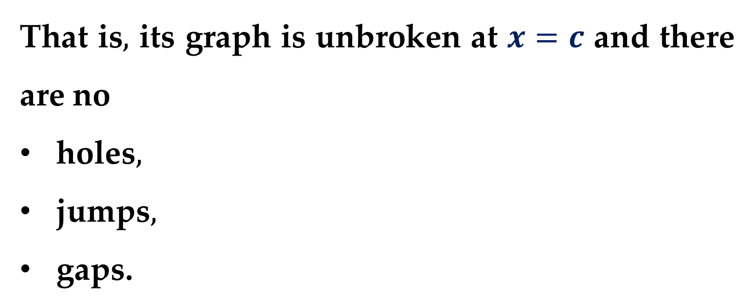
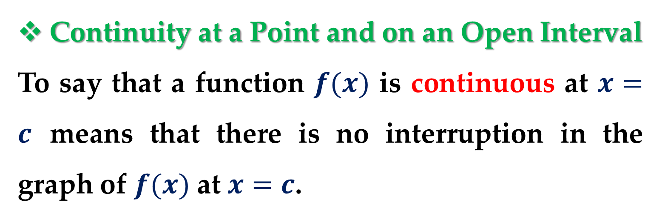
Continuity at a Point and on an Open Interval
To say that a function $f(x)$ is continuous at $x=c$ means that there is no interruption in the graph of $f(x)$ at $x=c$.
That is$,$ its graph is unbroken at $x=c$ and there are no
holes$,$
jumps$,$
gaps.

Slide 5
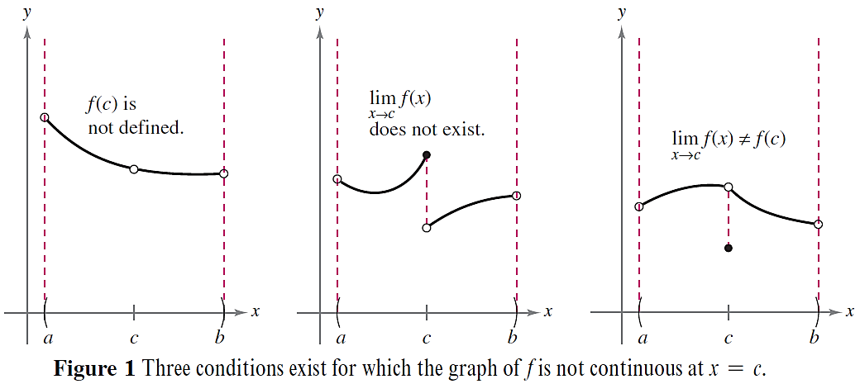
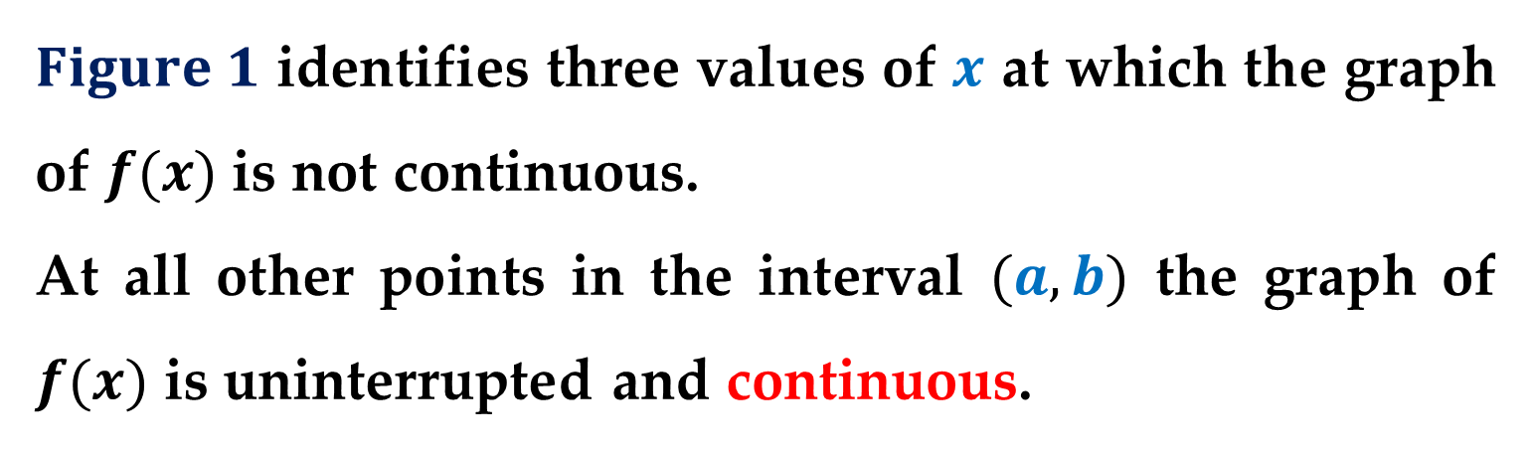
$Figure 1$ identifies three values of $x$ at which the graph of $f(x)$is not continuous.
At all other points in the interval $(a,b)$ the graph of $f(x)$ is uninterrupted and continuous.

Slide 6
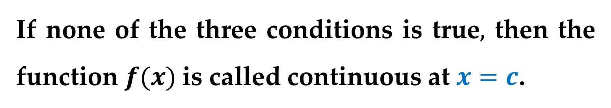
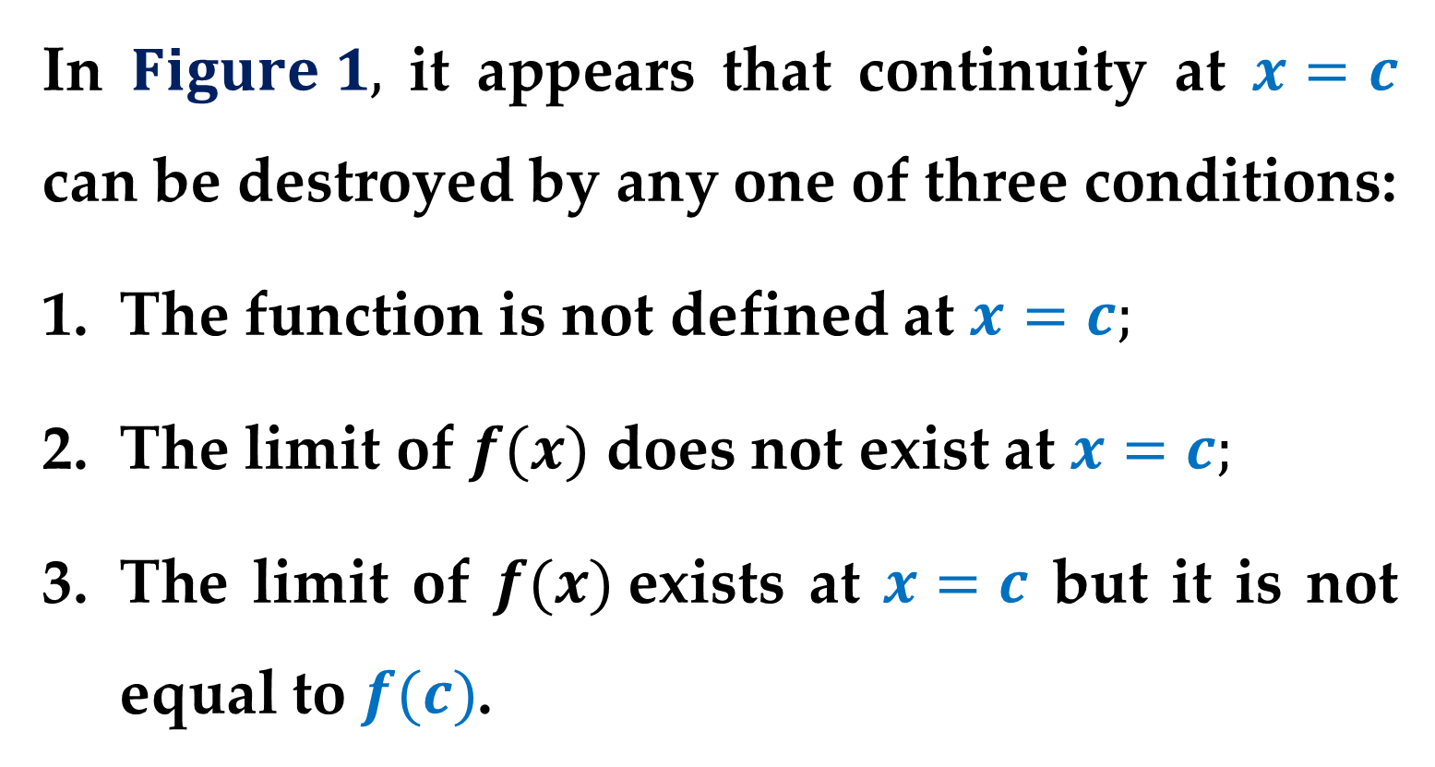
In $Figure 1,$ it appears that continuity at $x=c$ can be destroyed by any one of three conditions:
The function is not defined at $x=c;$
The limit of $f(x)$ does not exist at $x=c;$
The limit of $f(x)$exists at $x=c$ but it is not equal to $f(c)$.
If none of the three conditions is true$,$ then the function $f(x)$is called continuous at $x=c$.

Slide 7
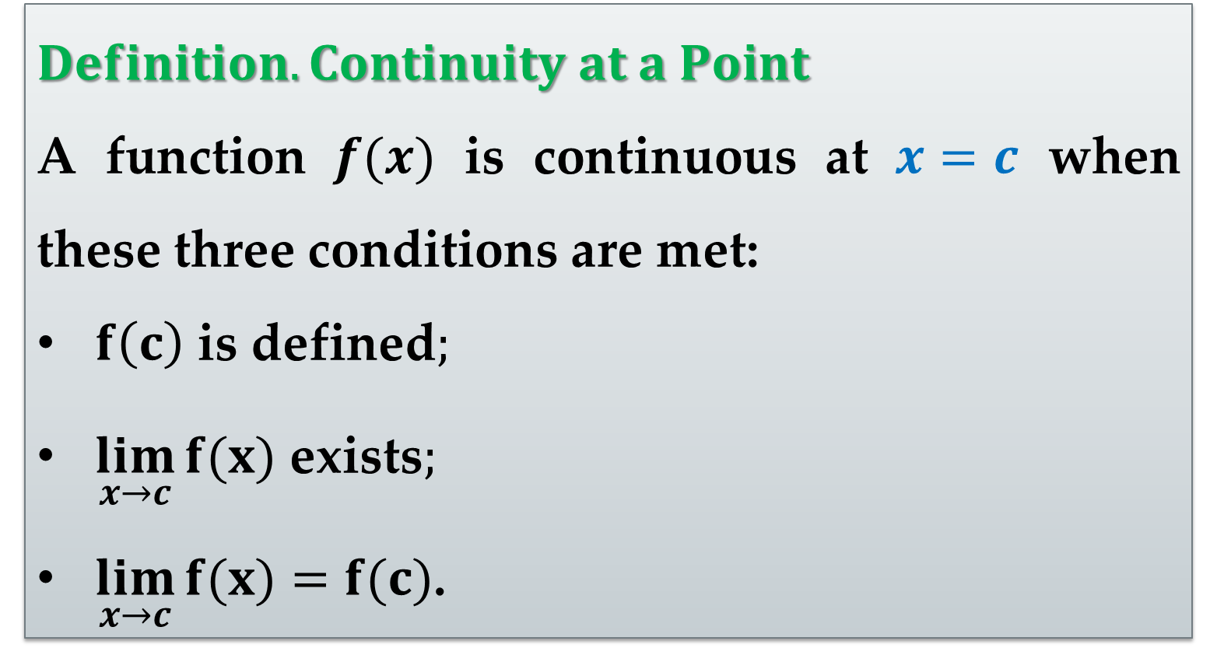
$Definition. Continuity at a Point$
A function $f(x)$ is continuous at $x=c$ when these three conditions are met:
$f\left(c\right)$ is defined$;$
$\lim_{x→c}{f(x)}$ exists$;$
$\lim_{x→c}{f(x)}=f(c)$.

Slide 8
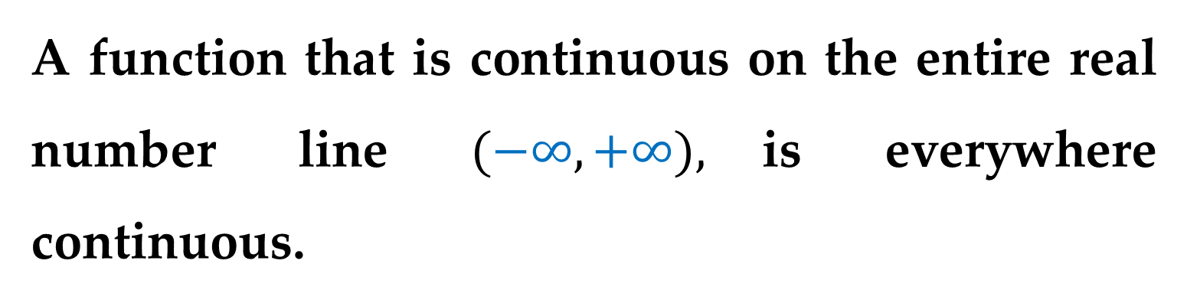
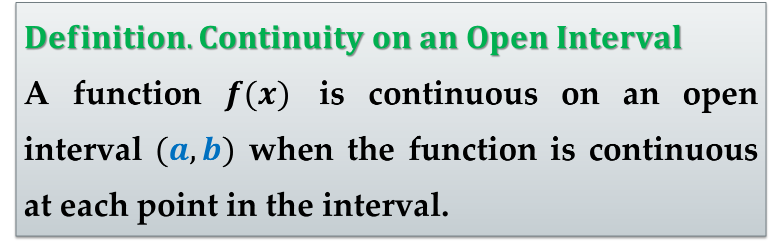
$Definition. Continuity on an Open Interval$
A function $f(x)$ is continuous on an open interval $(a,b)$ when the function is continuous at each point in the interval.
A function that is continuous on the entire real number line $(−∞,+∞),$is everywhere continuous.

Slide 9
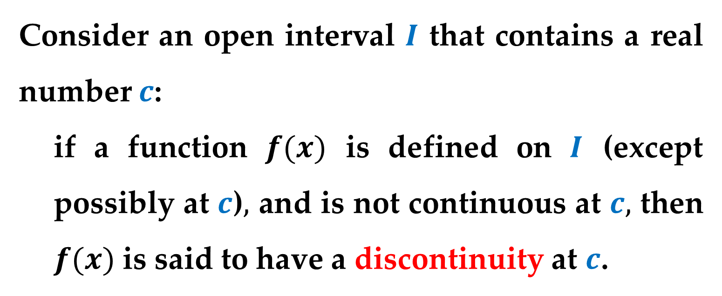
Consider an open interval $I$ that contains a real number $c$:
if a function $f(x)$ is defined on $I$ (except possibly at $c$)$,$ and is not continuous at $c,$ then $f(x)$ is said to have a discontinuity at $c$.
Discontinuities fall into two categories:
removable
non-removable

Slide 10
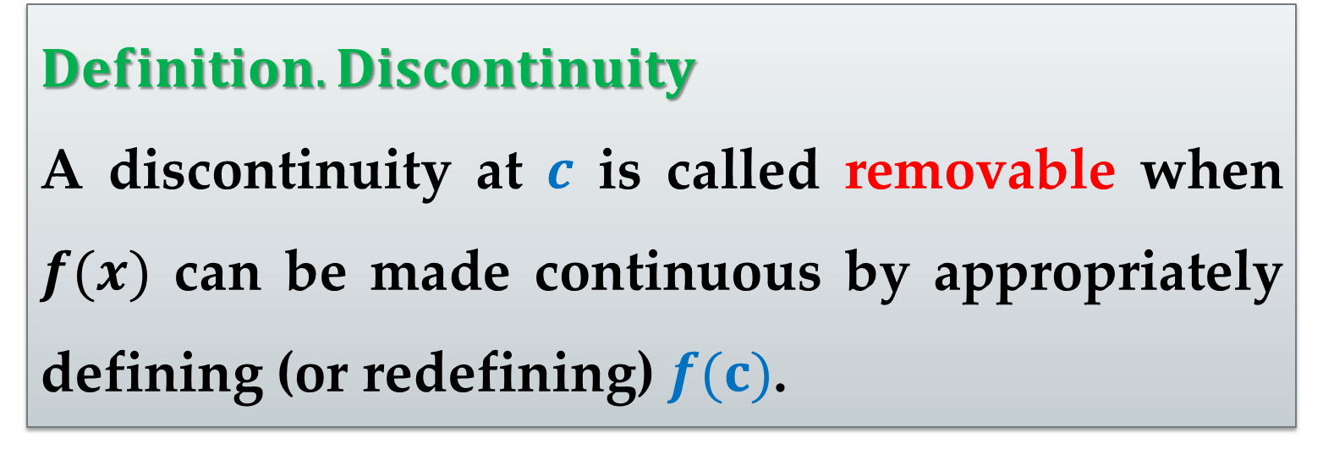
$Definition. Discontinuity$
A discontinuity at $c$ is called removable when $f(x)$ can be made continuous by appropriately defining (or redefining) $f(c)$.

Slide 11
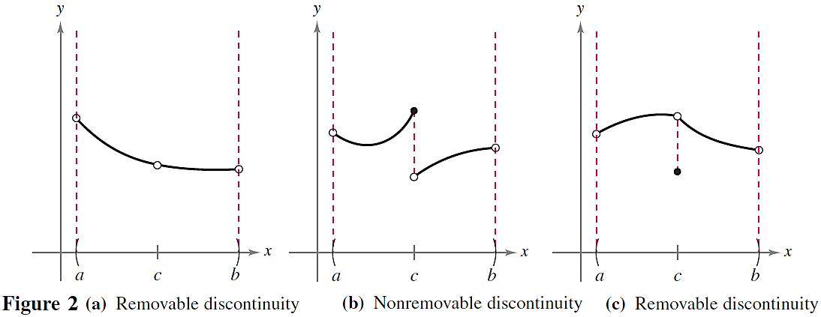
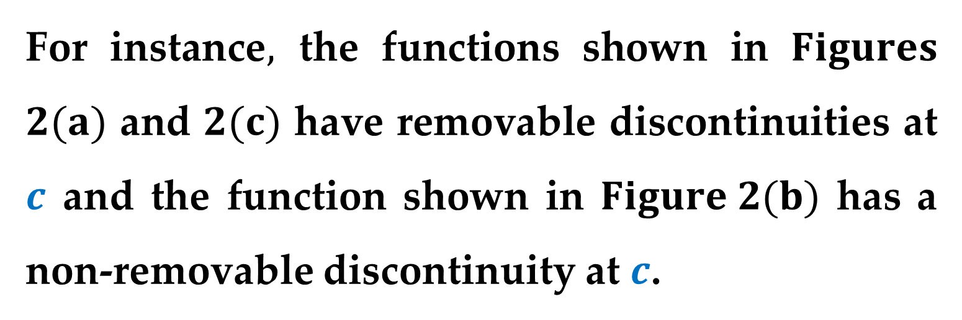
For instance$,$ the functions shown in $Figures$ $2(a)$ and $2(c)$ have removable discontinuities at $c$ and the function shown in $Figure 2(b)$ has a non-removable discontinuity at $c$.

Slide 12
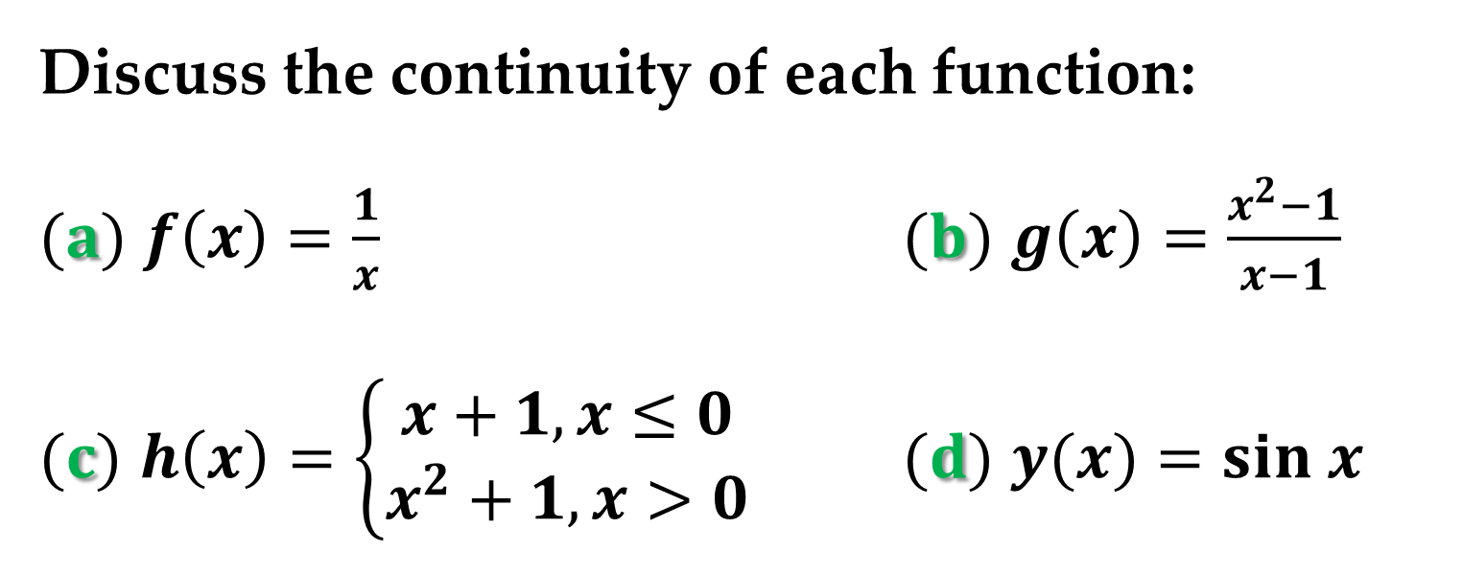
$Example 1. Continuity of a Function$
Discuss the continuity of each function:
$(a)$ $f\left(x\right)=\frac{1}{x}$ $(b)$ $g\left(x\right)=\frac{x^{2}−1}{x−1}$
$(c)$ $h\left(x\right)=\left\{\begin{aligned}x+1, x≤0 \\ x^{2}+1, x>0\end{aligned}\right.$ $(d)$ $y(x)=sin x$

Slide 13
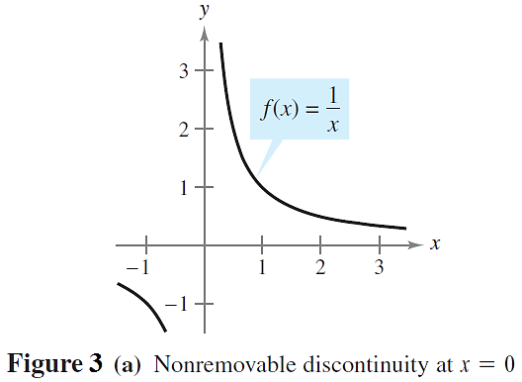
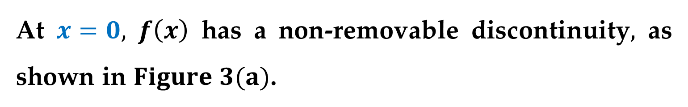
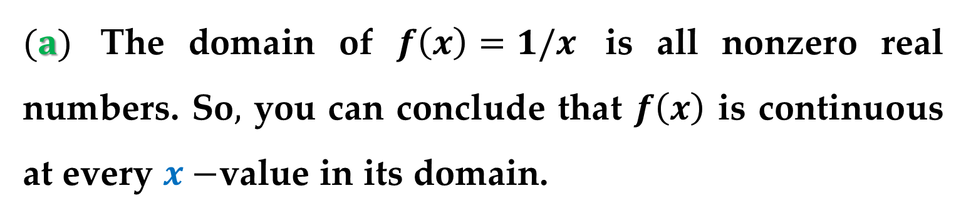
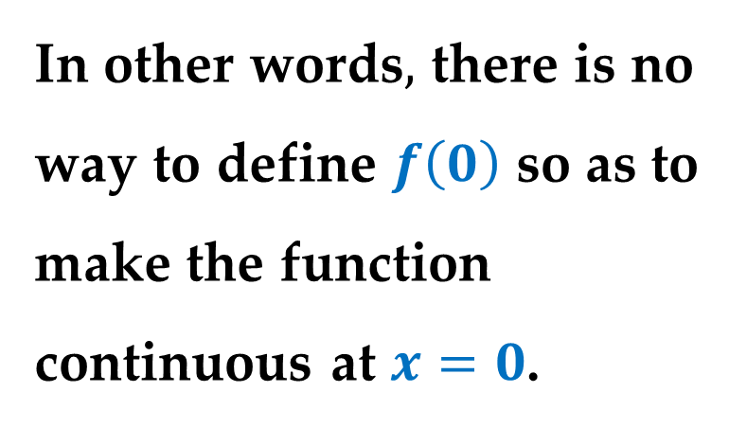
Solution
$(a)$ The domain of $f\left(x\right)=1/x$ is all nonzero real numbers. So$,$ you can conclude that $f\left(x\right)$ is continuous at every $x−$value in its domain.
At $x=0,$ $f\left(x\right)$ has a non-removable discontinuity$,$ as shown in $Figure 3(a)$.
In other words$,$ there is no way to define $f\left(0\right)$ so as to make the function continuous at $x=0$.

Slide 14
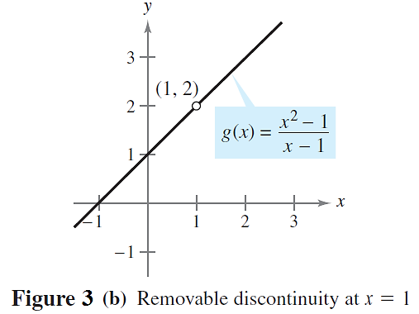
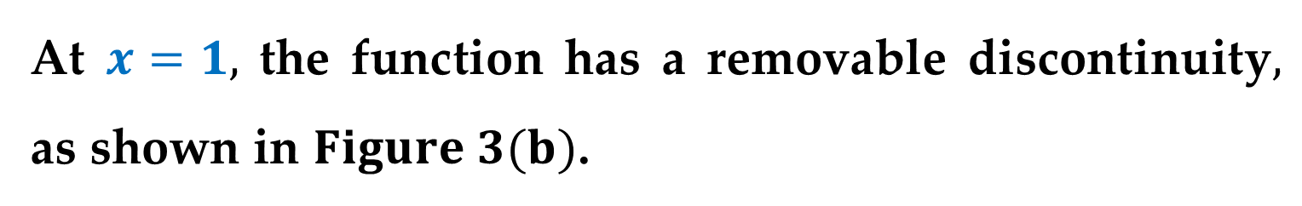
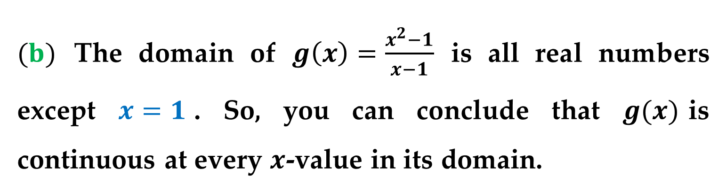
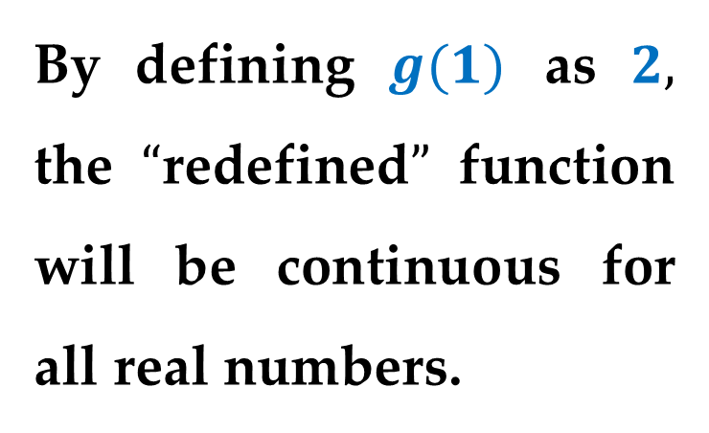
Solution (continued)
$(b)$ The domain of $g\left(x\right)=\frac{x^{2}−1}{x−1}$ is all real numbers except $x=1$. So, you can conclude that $g(x)$is continuous at every $x$-value in its domain.
At $x=1,$ the function has a removable discontinuity$,$ as shown in $Figure 3(b)$.
By defining $g(1)$ as $2,$ the $“$redefined$”$ function will be continuous for all real numbers.

Slide 15
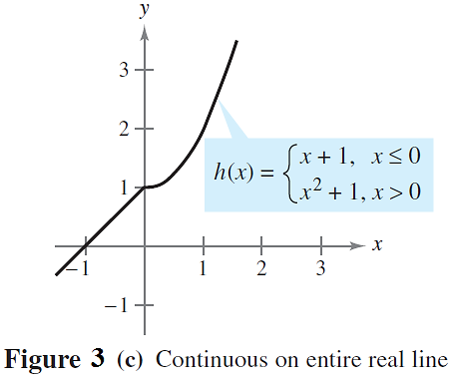
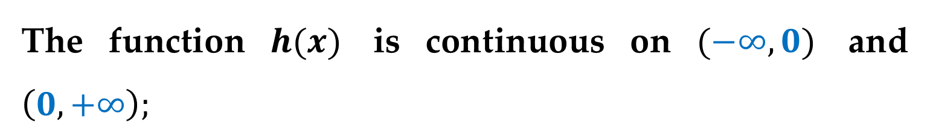
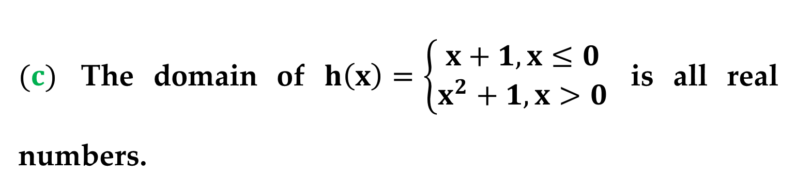
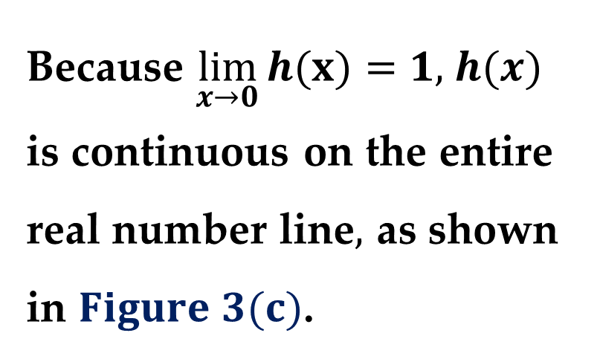
Solution (continued)
$(c)$ The domain of $h\left(x\right)=\left\{\begin{aligned}x+1, x≤0 \\ x^{2}+1, x>0\end{aligned}\right.$ is all real numbers.
The function $h(x)$ is continuous on $(−∞,0)$ and $\left(0,+∞\right);$
Because $\lim_{x→0}{h(x)}=1,$ $h(x)$ is continuous on the entire real number line$,$ as shown in $Figure 3(c)$.

Slide 16
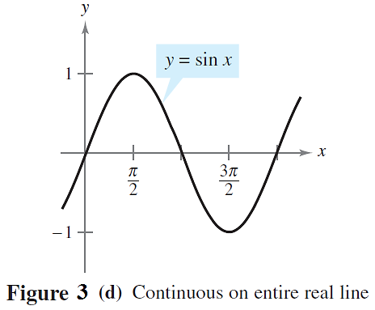
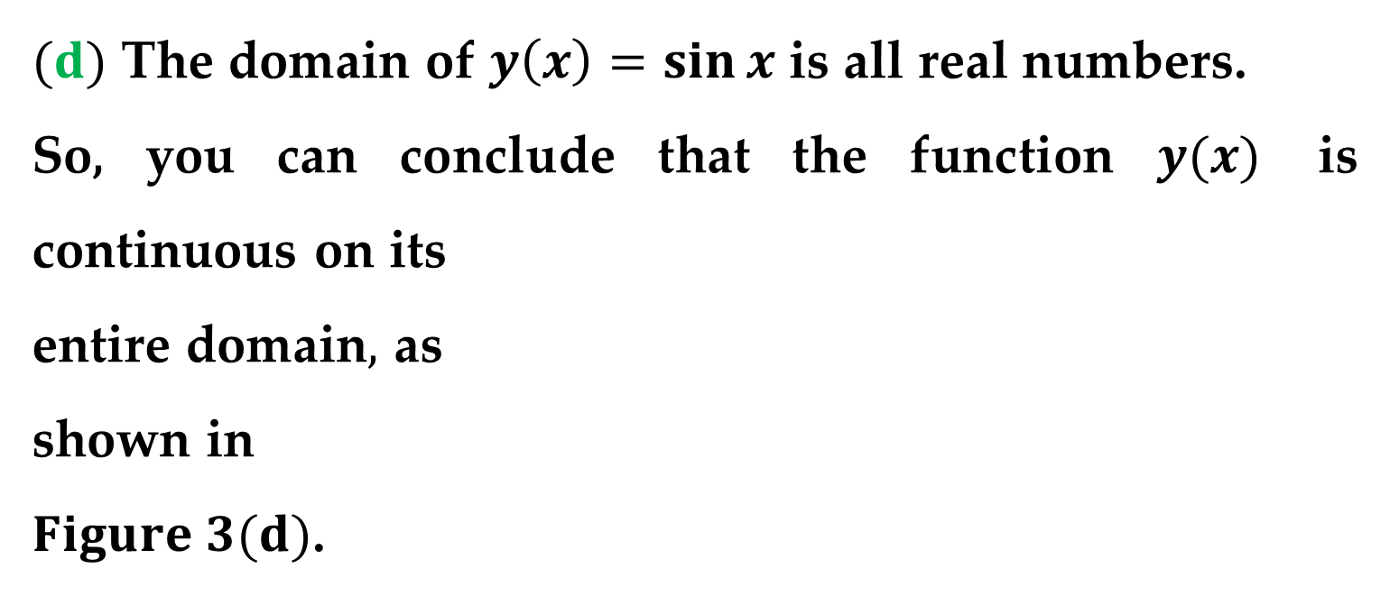
Solution (continued)
$(d)$ The domain of $y\left(x\right)=\sin{x}$ is all real numbers.
So, you can conclude that the function $y(x)$ is continuous on its
entire domain$,$ as
shown in
$Figure 3(d)$.

Slide 17
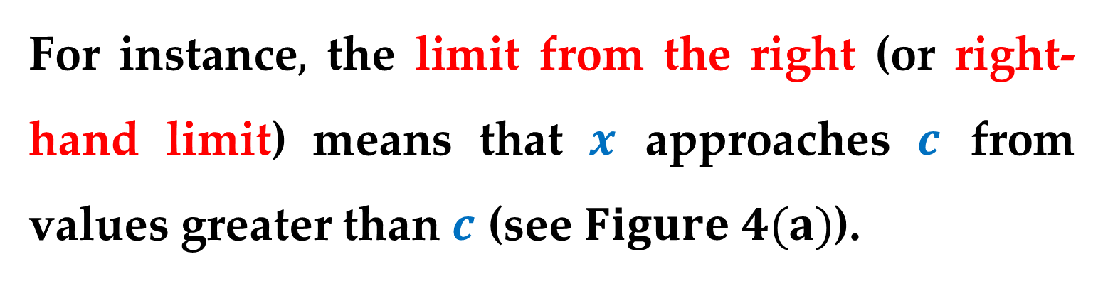
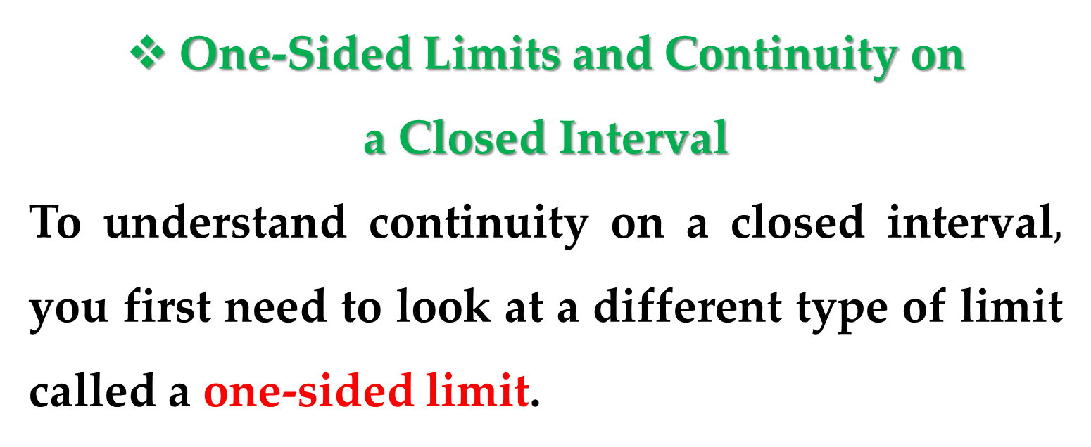
One-Sided Limits and Continuity on
a Closed Interval
To understand continuity on a closed interval$,$ you first need to look at a different type of limit called a one-sided limit.
For instance$,$ the limit from the right (or right-hand limit) means that $x$ approaches $c$ from values greater than $c$ (see $Figure 4(a)$).

Slide 18
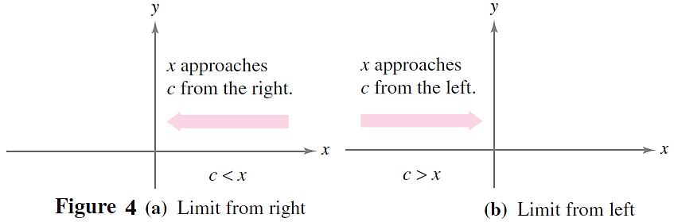
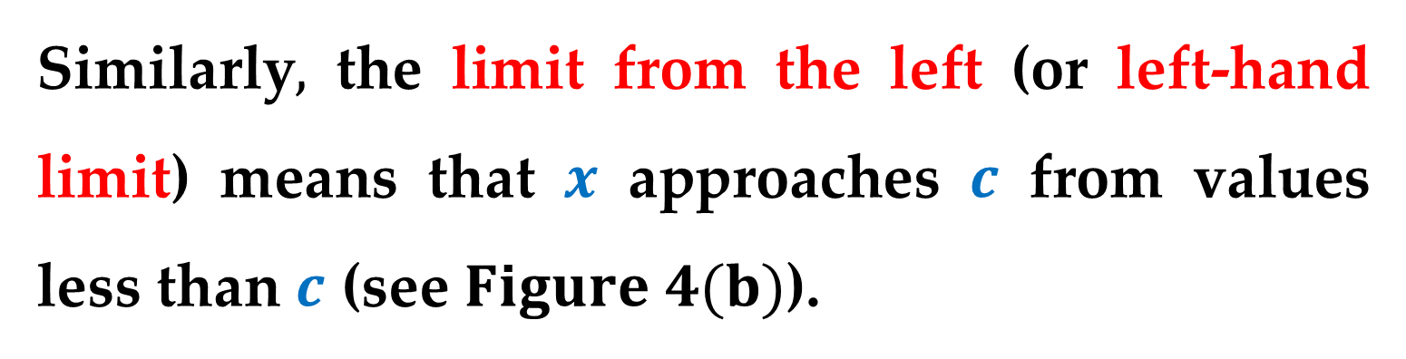
Similarly$,$ the limit from the left (or left-hand limit) means that $x$ approaches $c$ from values less than $c$ (see $Figure 4(b)$).

Slide 19
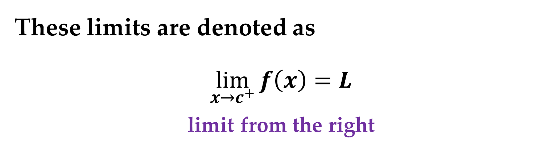

These limits are denoted as
$$\lim_{x→c^{+}}{f\left(x\right)}=L$$
limit from the right
$$\lim_{x→c^{−}}{f\left(x\right)}=L$$
limit from the left

Slide 20
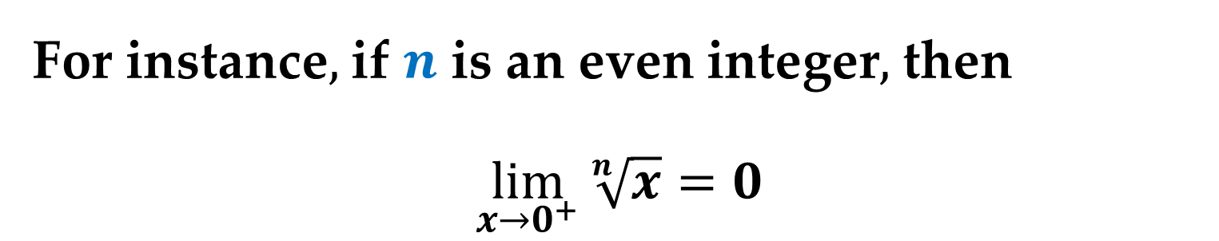
One-sided limits are useful in taking limits of functions involving radicals.
For instance$,$ if $n$ is an even integer$,$ then
$$\lim_{x→0^{+}}{\sqrt[n]{x}}=0$$

Slide 21
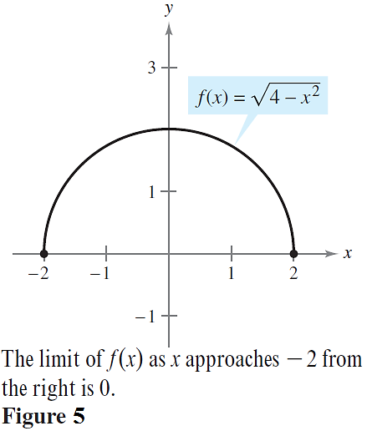
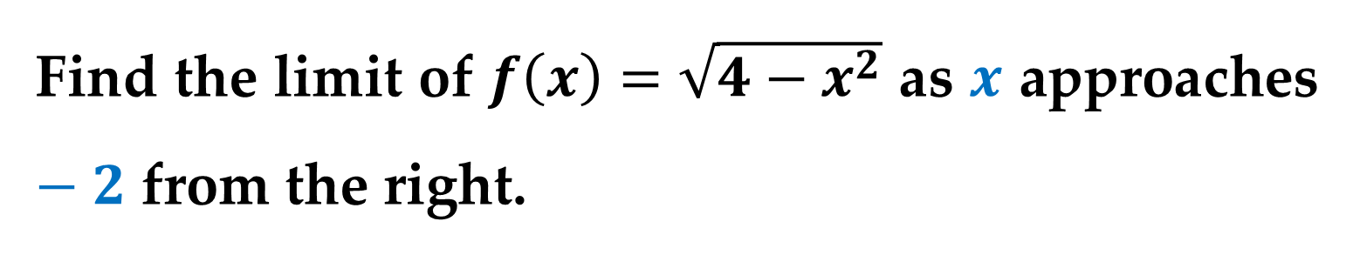
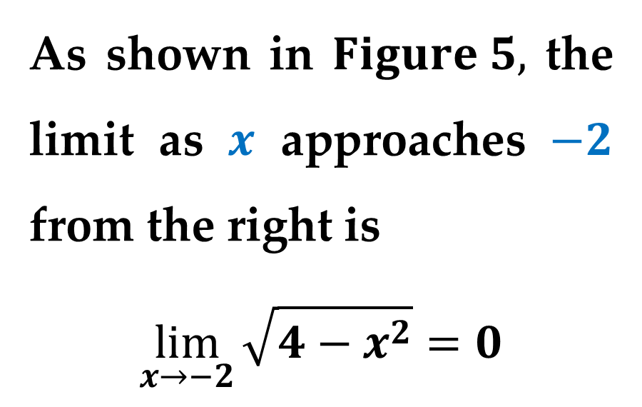
Example 2. A One-Sided Limit
Find the limit of $f\left(x\right)=\sqrt{4−x^{2}}$ as $x$ approaches $−2$ from the right.
Solution
As shown in $Figure 5,$ the limit as $x$ approaches $−2$ from the right is
$$\lim_{x→−2}{\sqrt{4−x^{2}}}=0$$

Slide 22
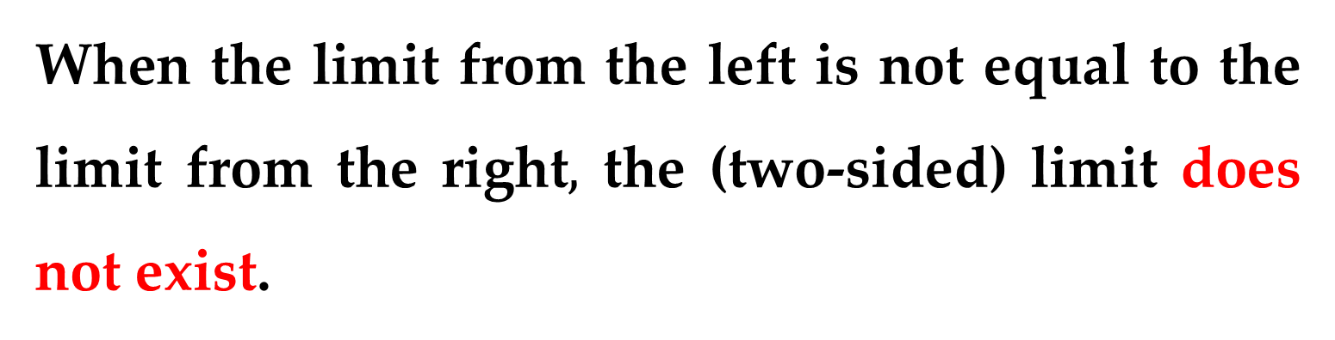
When the limit from the left is not equal to the limit from the right$,$ the (two-sided) limit does not exist.
The next theorem makes this more explicit (the proof of this theorem follows directly from the definition of a one-sided limit).

Slide 23
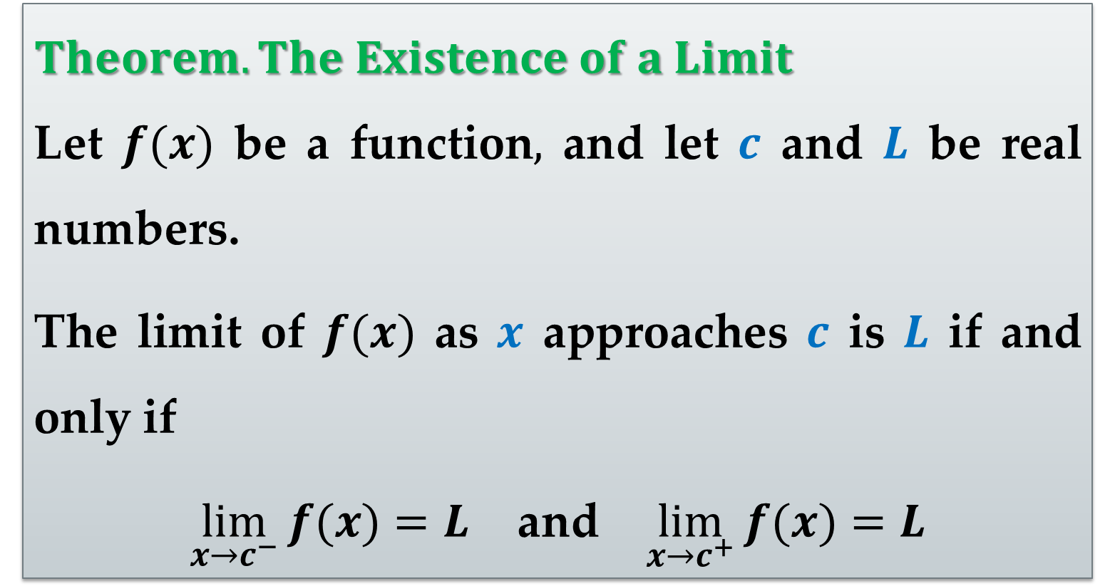
$Theorem. The Existence of a Limit$
Let $f(x)$ be a function$,$ and let $c$ and $L$ be real numbers.
The limit of $f(x)$ as $x$ approaches $c$ is $L$ if and only if
$\lim_{x→c^{−}}{f(x)}=L$ and $\lim_{x→c^{+}}{f(x)}=L$

Slide 24
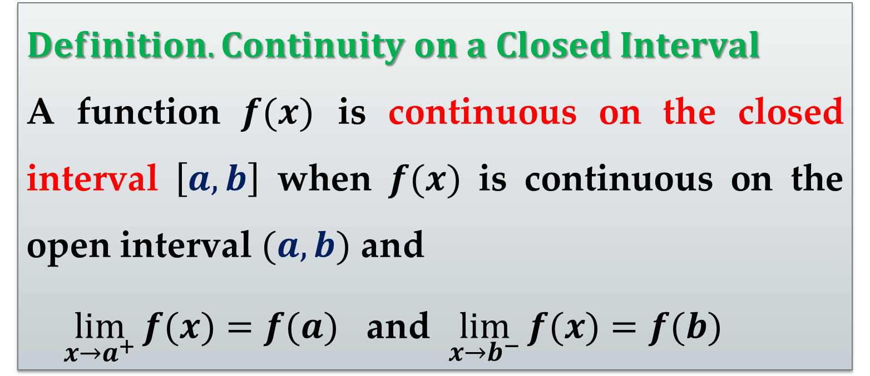
$Definition. Continuity on a Closed Interval$
A function $f(x)$ is continuous on the closed interval $\left[a,b\right]$ when $f(x)$ is continuous on the open interval $(a,b)$ and
$\lim_{x→a^{+}}{f(x)}=f(a)$ and $\lim_{x→b^{−}}{f(x)}=f(b)$

Slide 25
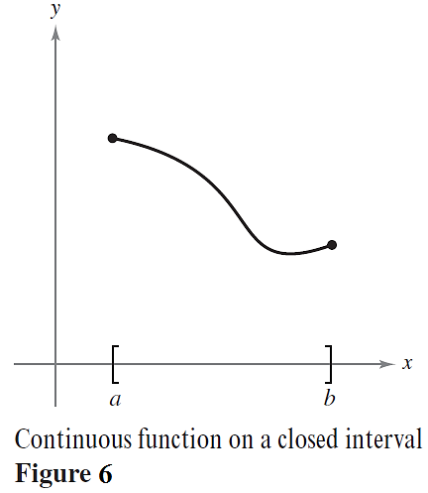
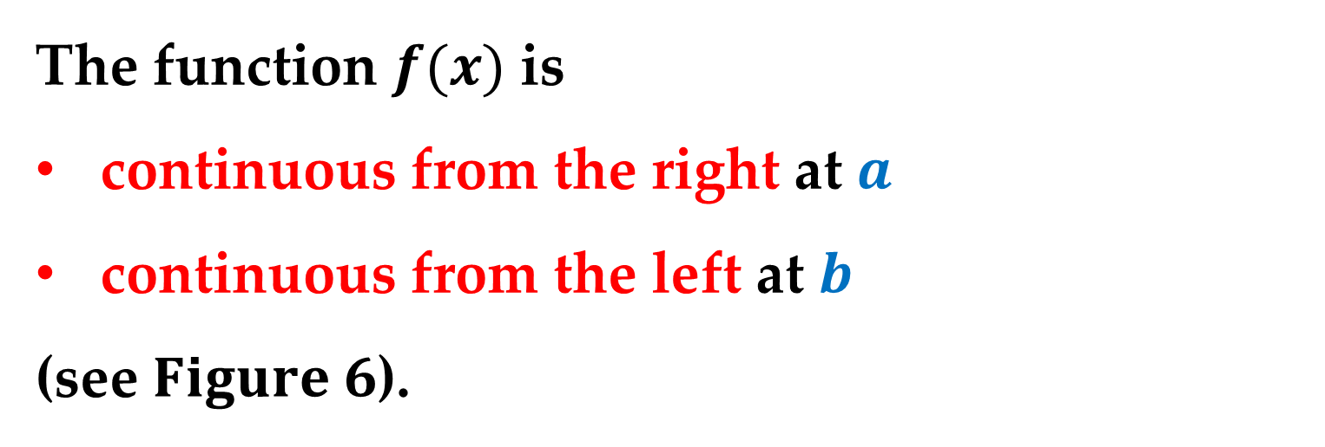
The function $f(x)$ is
continuous from the right at $a$
continuous from the left at $b$
(see $Figure 6$).

Slide 26
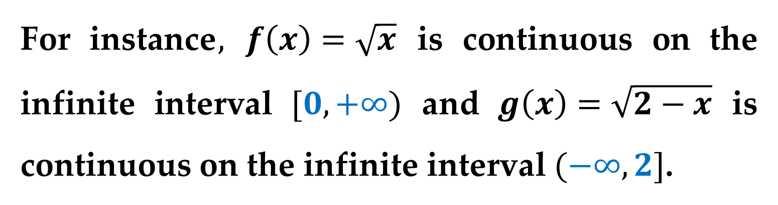
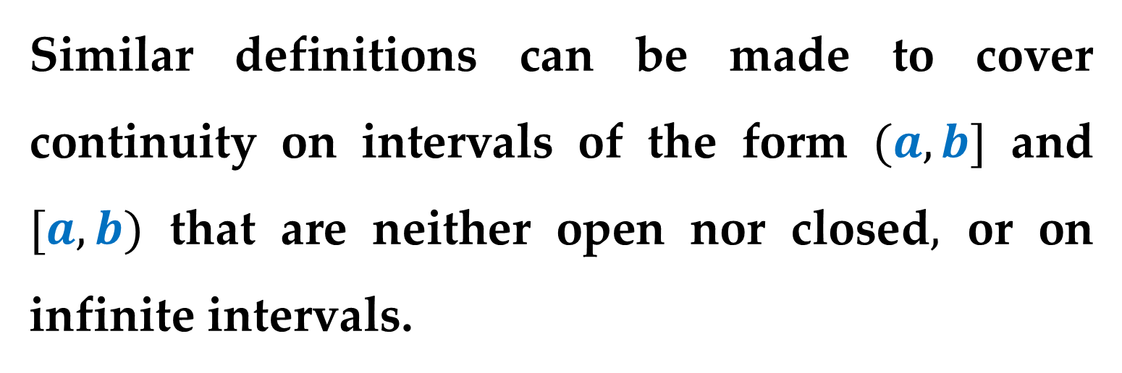
Similar definitions can be made to cover continuity on intervals of the form $(a,b]$ and $[a,b)$ that are neither open nor closed$,$ or on infinite intervals.
For instance$,$ $f\left(x\right)=\sqrt{x}$ is continuous on the infinite interval $[0,+∞)$ and $g\left(x\right)=\sqrt{2−x}$ is continuous on the infinite interval $(−∞,2]$.

Slide 27

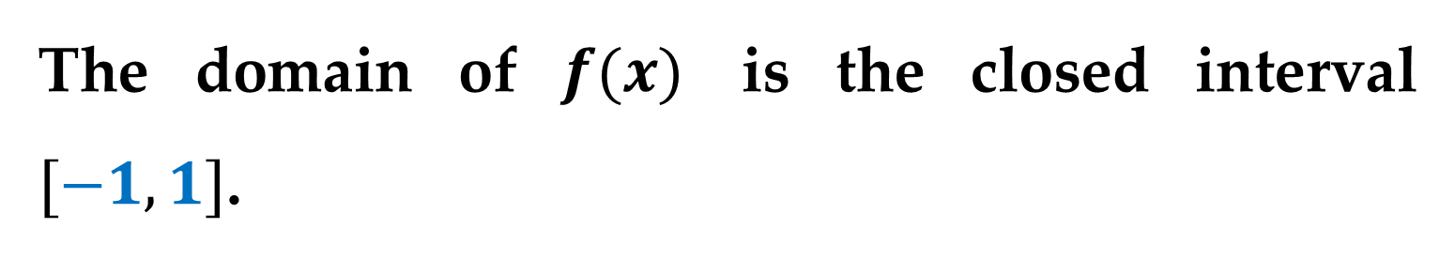
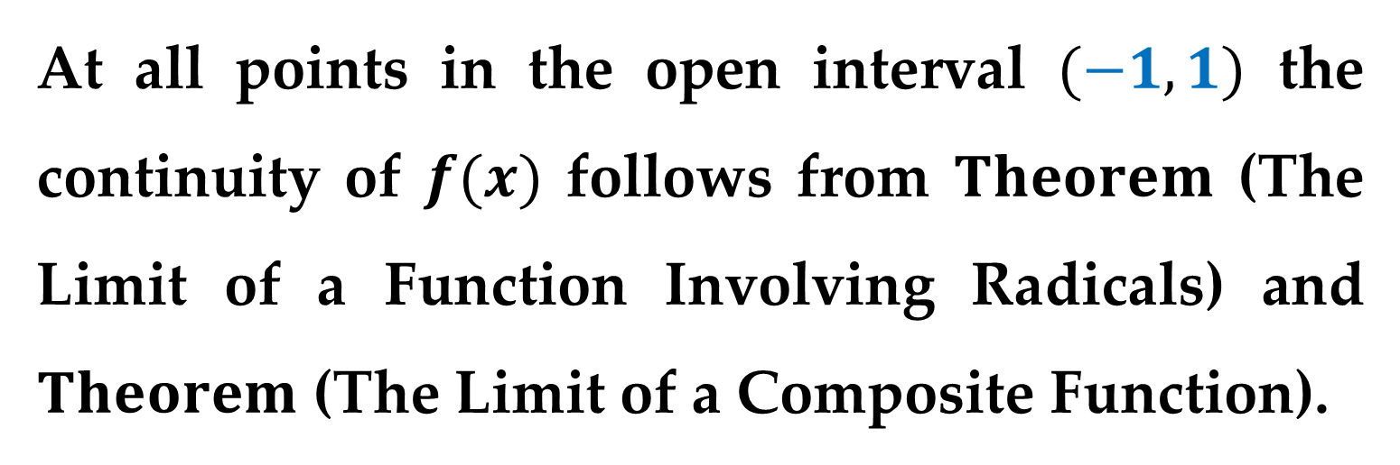
Example 3. Continuity on a Closed Interval
Discuss the continuity of $f\left(x\right)=\sqrt{1−x^{2}}$.
Solution
The domain of $f(x)$ is the closed interval $[−1,1]$.
At all points in the open interval $(−1,1)$ the continuity of $f(x)$ follows from $Theorem$ (The Limit of a Function Involving Radicals) and $Theorem$ (The Limit of a Composite Function).

Slide 28
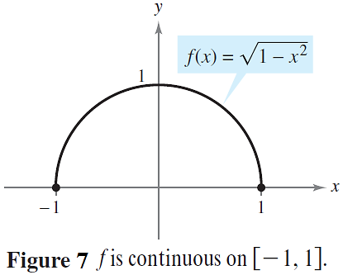
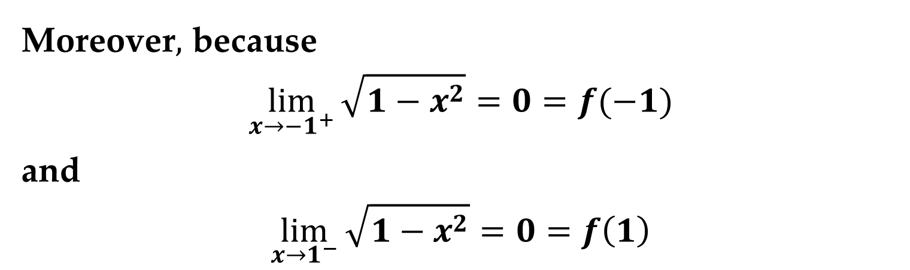
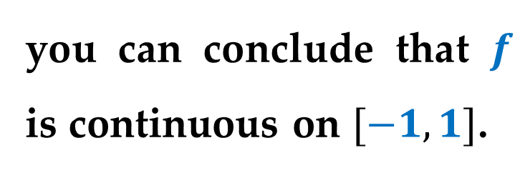
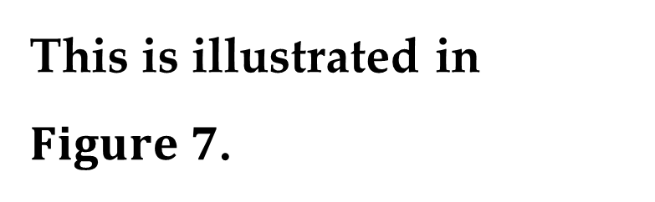
Solution (continued)
Moreover$,$ because
$$\lim_{x→{−1}^{+}}{\sqrt{1−x^{2}}}=0=f(−1)$$
and
$$\lim_{x→1^{−}}{\sqrt{1−x^{2}}}=0=f\left(1\right)$$
you can conclude that $f$ is continuous on $[−1,1]$.
This is illustrated in
$Figure 7$.

Slide 29
Properties of Continuity

Slide 30

$Theorem. Properties of Continuity$
If $b$ is a real number and $f(x)$ and $g(x)$ are continuous at $x=c,$ then the functions listed below are also continuous at $x=c$:
1. Scalar multiple: $bf(x)$
2. Sum or Difference: $f(x)±g(x)$
3. Product: $f(x)g(x)$
4. Quotient: $\frac{f\left(x\right)}{g\left(x\right)}$ provided that $g(c)≠0$.

Slide 31




It is important to be able to recognize functions that are continuous at every point in their domains:
Polynomial
$$p\left(x\right)=a_{n}x^{n}+a_{n−1}x^{n−1}+…+a_{1}x+a_{0}$$
Rational
$r\left(x\right)=p(x)/q(x)$ provided that $q(x)≠0$
Radical
$$f\left(x\right)=\sqrt[n]{x}$$
Trigonometric
$$\sin{x},\cos{x},\tan{x}, cot x, sec x,\csc{x}$$

Slide 32


Example 5. Applying Properties of Continuity
Discuss the continuity of the functions below
$$f\left(x\right)=x+sin x$$
$$g\left(x\right)=3 tan x$$
$$h\left(x\right)=\frac{x^{2}+1}{cos x}$$
Solution
By the last Theorem$,$ it follows that each of the functions above is continuous at every point in its domain.

Slide 33

$Theorem. Continuity of a Composite Function$
If $g(x)$ is continuous at $x=c$ and $f(y)$ is continuous at $y=g(c)$, then the composite function given by
$$\left(f∘g\right)\left(x\right)=f\left(g\left(x\right)\right)$$
is continuous at $c$.

Slide 34


Example 6. Testing for Continuity
Discuss the continuity of the functions below
$(a)$ $f\left(x\right)=tan x$ $(b)$ $g\left(x\right)=\left\{\begin{aligned}sin\frac{1}{x}, x≠0 \\ 0, x=0\end{aligned}\right.$
$(c)$ $h\left(x\right)=\left\{\begin{aligned}x sin\frac{1}{x}, x≠0 \\ 0, x=0\end{aligned}\right.$
Solution
$(a)$ The tangent function $f(x)$ is undefined at
$x=\frac{π}{2}+nπ$ ($n$ is an integer)
At all other points it is continuous.

Slide 35


Solution (continued)
So$,$ $f(x)$ is continuous on the open intervals
$…, \left(−\frac{3π}{2},−\frac{π}{2}\right); \left(−\frac{π}{2},\frac{π}{2}\right), \left(\frac{π}{2},\frac{3π}{2}\right),…$

Slide 36


Solution (continued)
$(b)$ Because $g\left(x\right)$ is continuous except at $x=0,$ and the sine function is continuous for all real values of $x,$ it follows from the last Theorem that $y\left(x\right)=\sin{\frac{1}{x}}$ is continuous at all real values except $x=0$.
At $x=0$ the limit of $g(x)$ does not exist.
So$,$ $g(x)$ is continuous on the intervals $(−∞,0)$ and $(0,+∞)$.

Slide 37

Solution (continued)

Slide 38


Solution (continued)
$(c)$ The function $h(x)$ is similar to the function $g(x)$ except that the oscillations are damped by the factor $x$.
Using the $Squeeze Theorem,$ we obtain
$$−\left|x\right|≤x∙\sin{\frac{1}{x}}≤\left|x\right| , x≠0$$
and we can conclude that
$$\lim_{x→0}{h(x)}=0$$

Slide 39


Solution (continued)
So$,$ $h(x)$ is continuous on the entire real number line$,$ as shown in $Figure 8(c)$.

Slide 40
The Intermediate Value Theorem

Slide 41


$Theorem. Intermediate Value$
If $f(x)$ is continuous on the closed interval $[a,b],$ $f(a)≠f(b),$ and $k$ is any number between $f(a)$ and $f(b),$ then there is at least one number $c$ in $(a,b)$ such that $f\left(c\right)=k$.
The Intermediate Value Theorem guarantees the existence of at least one number $c$ in the closed interval $[a,b],$ but it does not provide a method for finding $c$.

Slide 42


Such theorems are called existence theorems.
There may$,$ of course$,$ be more than one number $c$ in the closed interval
$[a,b]$ such that
$f\left(c\right)=k,$ as shown
in $Figure 9$.

Slide 43


A function that is not continuous does not necessarily exhibit the intermediate value property.
For example$,$ the graph of the function shown in $Figure 10$ jumps over the horizontal line $y=k$ and for this function there is no value of $c$ in $[a,b]$ such that $f(c)=k$.

Slide 44


The $Intermediate Value Theorem$ often can be used to locate the zeros of a function that is continuous on a closed interval.
Specifically$,$ if $f(x)$ is continuous on $[a,b]$ and $f(a)$ and $f(b)$ differ in sign, then the $Intermediate Value Theorem$ guarantees the existence of at least one zero of $f(x)$ in the closed interval $[a,b]$.

Slide 45



$$Example 7. An Application of the Intermediate Value$$
$$Theorem$$
Use the Intermediate Value Theorem to show that the polynomial function
$$p\left(x\right)=x^{3}+2x−1$$
has a zero in the interval $[0,1]$.
Solution
Note that $p\left(x\right)$ is continuous on the closed interval $[0,1]$. Because
$p\left(0\right)=−1$ and $p\left(1\right)=2$
it follows that $p\left(0\right)<0$ and $p\left(1\right)>0$.

Slide 46


Solution (continued)
You can therefore apply the Intermediate Value Theorem to conclude that there must be some $c$ in $[0,1]$ such that $f\left(c\right)=0$ (see $Figure 11$).

Slide 47

The bisection method for approximating the real zeros of a continuous function is similar to the method used in the previous example.
If you know that a zero exists in the closed interval $[a,b],$ then the zero must lie in the interval
$[a,(a+b)/2]$ or $[(a+b)/2,b]$

Slide 48


From the sign of
$$f\left(\frac{a+b}{2}\right)$$
you can determine which of the two intervals contains the zero.
By repeatedly bisecting the interval$,$ we can $“$close in$”$ on the zero of the function.

Slide 49
Thank you for attention

